Slide 1
Homework 6

Slide 2
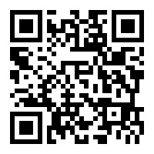
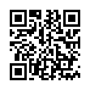
Homework 6
Record a video to introduce your final project
About 10 mins
Upload to Youtube
Create a QR code
https://www.the-qrcode-generator.com/
E.g
https://www.youtube.com/watch?v=Uj-J8dEFkRY
https://www.youtube.com/watch?v=dze9mOm71Uk

Slide 3
Homework 6
Software
Camtasia Studio
https://www.techsmith.com/camtasia.html
Screencast
http://www.screencast-o-matic.com/
Obs
https://www.yzu.edu.tw/admin/aa/files/aatsc/OBS_Studio%E8%BB%9F%E9%AB%94%E5%AE%89%E8%A3%9D%E4%BD%BF%E7%94%A8%E5%8F%8A%E7%9B%B8%E9%97%9C%E8%A8%AD%E5%AE%9A%E8%AA%AA%E6%98%8E.pdf
…

Slide 4
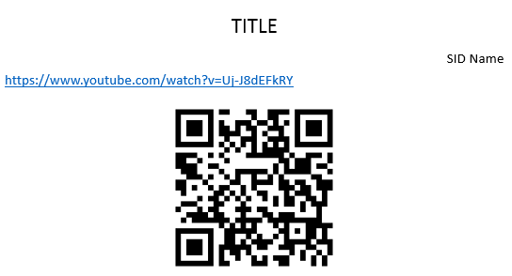
Homework 6
Submit
Portal
A word/PDF file
Filename
SID_hw6.docx or SID_hw6.pdf
Content
URL & QRcode
Deadline
2022/06/20 23:59

